Slide 1
Multi-Point Machining: Drilling
Lecture 25

Slide 2
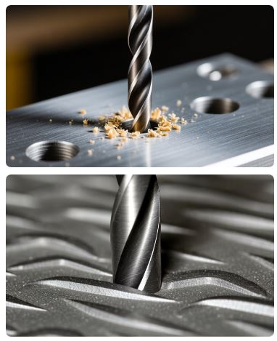
What is Multi-Point Drilling?
Multi-Point Cutting Process
Drilling uses multi-point cutting tools with two or more cutting edges that simultaneously engage with the workpiece to create round holes by removing material through rotational motion and axial feed.
Rotary Cutting
Multiple cutting lips work together to remove material efficiently while creating precise circular holes.
Axial Feed
Simultaneous rotation and linear motion create holes with controlled depth and diameter accuracy.

Slide 3
Drilling Process Overview
Core Drilling Definition
Drilling is a subtractive manufacturing process that uses rotating multi-point cutting tools to create round holes in solid materials by combining rotational motion with axial feed force.
Rotational Motion
Cutting tool rotates while advancing axially into stationary workpiece
Axial Force
Controlled feed pressure creates precise hole geometry
Depth Control
Accurate hole depth through programmable feed rates

Slide 4
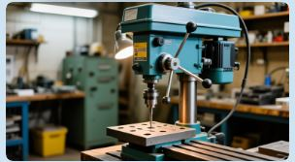
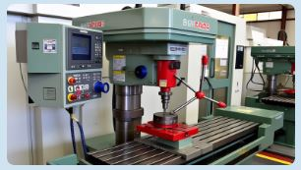
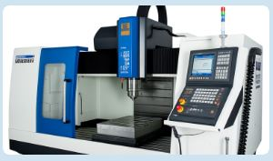
Types of Drilling Machines
Bench Drilling Machine
Compact and portable design
Manual feed control
Ideal for small workshops
Light-duty applications
CNC Drilling Center
Computer-controlled precision
Automatic tool changing
Complex hole patterns
High-volume production
Radial Drilling Machine
Adjustable radial arm
Large workpiece capacity
Heavy-duty operations
Multiple spindle speeds

Slide 5
Drilling Machine Components
Essential Machine Elements
Understanding the key components that enable precise multi-point drilling operations in modern drilling systems.
Spindle System
High-speed rotating spindle
Precision bearings and seals
Variable speed control
Worktable Assembly
Adjustable worktable height
T-slots for workholding
Precision positioning system
Feed Mechanism
Manual or automatic feed control
Coolant System
Chip evacuation and cooling
Safety Guards
Operator protection systems

Slide 6
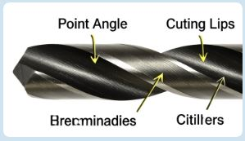
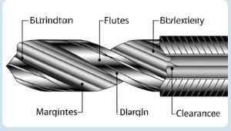
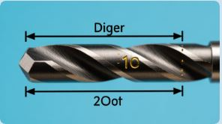
Twist Drill Geometry
Point Geometry
Point angle (118° or 135°)
Cutting lips and chisel edge
Web thickness and taper
Helix angle for chip flow
Flute Design
Spiral flutes for chip evacuation
Land and margin for guidance
Body clearance for reduced friction
Coolant holes for deep drilling
Dimensional Accuracy
Diameter tolerance standards
Length and flute specifications
Surface finish requirements
Concentricity standards

Slide 7
Drilling Tool Materials
High-Speed Steel (HSS)
General purpose drill material with good toughness and heat resistance for standard applications
M2 and M35 HSS grades
Cost-effective for most materials
Good for low to medium speeds
Easy to regrind and resharpen
Carbide Drills
Ultra-hard material for high-speed drilling and difficult-to-machine materials
Tungsten carbide substrate
Titanium nitride coatings
High-speed capability
Superior wear resistance

Slide 8
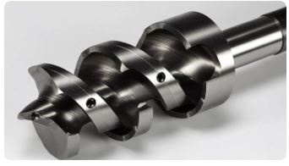
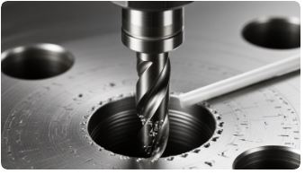
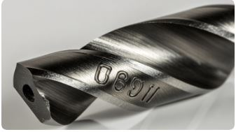
Specialized Drilling Tools
Center Drills
Short, rigid tools for creating accurate starting holes and 60-degree center holes for lathe work.
Deep Hole Drills
Specialized tools with internal coolant for drilling holes with length-to-diameter ratios exceeding 10:1.
Step Drills
Multi-diameter tools for creating stepped holes without tool changes, ideal for sheet metal applications.

Slide 9

Drilling Process Parameters
Cutting Speed (Vc)
Surface speed of the drill measured in m/min or SFM. Critical for tool life and hole quality optimization.
Feed Rate (f)
Rate of drill advancement into the workpiece, measured in mm/rev or IPR. Affects chip formation and hole accuracy.
Thrust Force
Axial force required for penetration. Monitored to prevent drill breakage and ensure consistent quality.

Slide 10
Drilling Operations Analysis
Strengths of Drilling
High precision holes, versatile applications, cost-effective, automated operation, and excellent repeatability.
Process Limitations
Tool wear issues, chip evacuation challenges, limited to round holes, and breakthrough burrs.
S
W
T
O
Technology
Opportunities
Peck drilling, through-tool coolant, advanced coatings, and AI optimization systems.
Market Threats
Alternative hole-making methods, material hardness limitations, and skilled operator shortage.

Slide 11
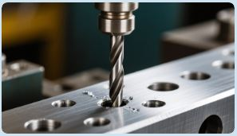
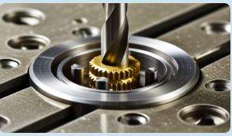
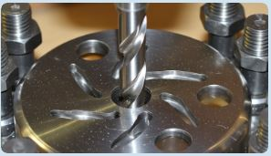
Types of Drilling Operations
Conventional Drilling
Creates round holes in solid material
Standard twist drill geometry
Through and blind holes
Most common operation
Step Drilling
Multiple diameters in one pass
Reduces tool changes
Improved concentricity
Time-saving operation
Counterboring
Enlarges hole for bolt heads
Creates flat bottom surface
Precise depth control
Clean finish quality

Slide 12
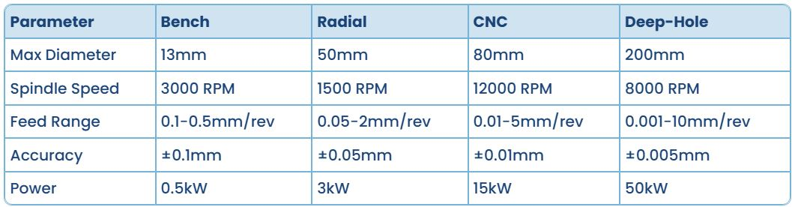
Standard Drilling Specifications
Common specifications for modern drilling machines across different size categories and applications

Slide 13
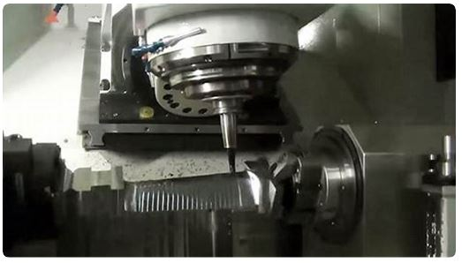
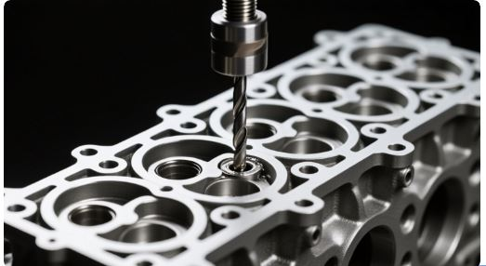
Industrial Applications
Automotive Manufacturing
Engine block bolt holes
Transmission housing holes
Brake component mounting
Rapid prototyping applications
Aerospace Components
Turbine blade cooling holes
Structural aircraft components
Lightweight aluminum drilling
Precision fuel system holes

Slide 14
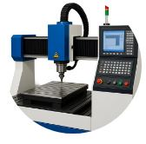
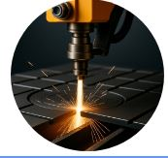
Advanced Drilling Technologies
CNC Drilling Centers
Computer-controlled drilling systems enable precise positioning, automatic tool changing, and complex hole patterns with minimal human intervention for high-volume production.
High-Pressure Coolant
Advanced coolant systems deliver pressurized coolant through the drill tool, improving chip evacuation, tool life, and hole quality in deep-hole drilling applications.

Slide 15
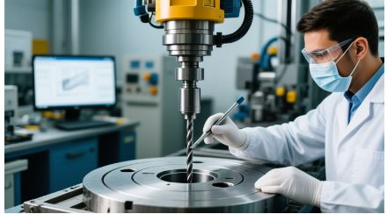
Drilling Workflow Process
CAD Design
Create hole patterns and generate drilling programs using CAM software for optimal tool paths and parameters.
Machine Setup
Configure tooling, workholding, and drilling parameters based on material properties and hole specifications.
Drilling Execution
Execute programmed operations with real-time monitoring for quality control and process optimization.

Slide 16
References / Further Readings
[1] Ghosh, A. & Mallik, A.K.; Joining processes, Manufacturing Science, Latest edition.
[2] https://fractory.com/heat-affected-zone-causes-effects-reduction/
[3] Kalpakjian, S & Schmid, S,; Manufacturing Processes for Engineering Materials, Latest edition.

Slide 17


